Slide 1
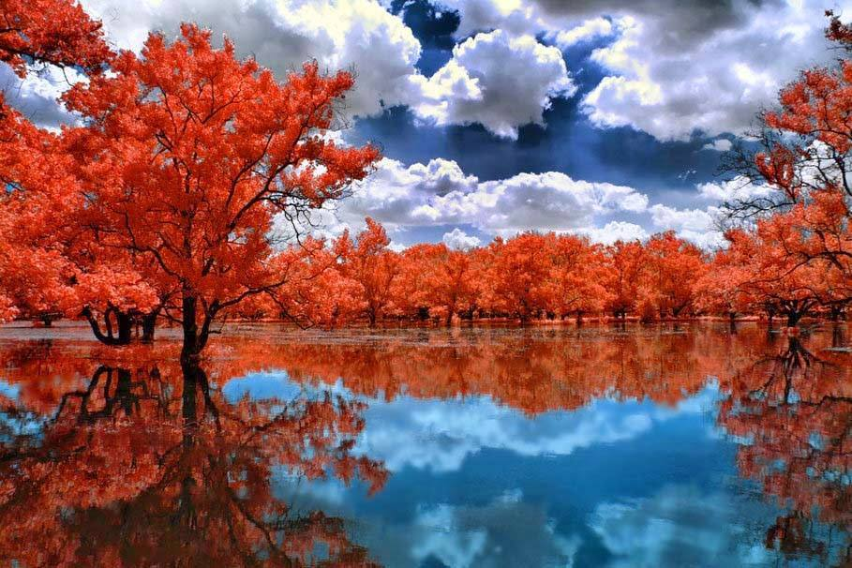
THE LIFE OF CHRIST
PART 57

Slide 2

Luke 10:25 And behold, a certain lawyer stood up and tested Him, saying, "Teacher, what shall I do to inherit eternal life?"

Slide 3
According Thayer a lawyer is:
one learned in the law, in the N. T. an interpreter and teacher of the Mosaic law.

Slide 4
Tested: 1) to prove, test, thoroughly 2) to put to proof God's character and power (Strongs).

Slide 5
Luke 10:26 He said to him, "What is written in the law? What is your reading of it?" ²⁷ So he answered and said, " 'You shall love the LORD your God with all your heart, with all your soul, with all your strength, and with all your mind,' and 'your neighbor as yourself.'

Slide 6
Phylacteries consisted of “small strips of parchment on which were written the following passages from the law of Moses, Exo. 13:1-10,11-16; Deut. 6:4-9; 11:13-21, and which, enclosed in little cases, they were accustomed when engaged in prayer to wear fastened by a leather strap to the forehead and to the left arm over against the heart, in order that they might thus be solemnly reminded of the duty of keeping the commands of God in the head and in the heart, according to the directions given in Exo. 13:16; Deut. 6:8; 11:18; (cf. Josephus, Antiquities 4, 8, 13)” Thayer.

Slide 7
Luke 10:28 And He said to him, "You have answered rightly; do this and you will live."

Slide 8
Matthew 22:35 Then one of them, a lawyer, asked Him a question, testing Him, and saying, ³⁶ "Teacher, which is the great commandment in the law?" ³⁷ Jesus said to him, " 'You shall love the LORD your God with all your heart, with all your soul, and with all your mind.' ³⁸ "This is the first and great commandment. ³⁹ "And the second is like it: 'You shall love your neighbor as yourself.' ⁴⁰ "On these two commandments hang all the Law and the Prophets."

Slide 9
Many fanciful theories are put forward today as to what it means to love God.
However, Jesus did not leave His disciples in doubt. "If ye love me," He said in John 14:15, "keep my commandments." In this same chapter, He said, "He that hath my commandments and keepeth them, he it is that loveth me; and he that loveth me shall be loved of my Father; and I will love him and manifest myself to him" (John 14:21). Farther down He continued to explain: "If a man love me, he will keep my words; and my Father will love him, and we will come unto him, and make our abode with him.

Slide 10
He that loveth me not keepeth not my sayings: and the word which ye hear is not mine, but the Father's which sent me" (John 14:23-24). As proof of His own love of God, Jesus said, "... that the world may know that I love the Father; and as the Father gave me commandment, even so I do ..." (John 14:31; cf. 1 John 2:4-5). (Denton Lecturships on Matthew).

Slide 11
Luke 10:29 But he, wanting to justify himself, said to Jesus, "And who is my neighbor?"

Slide 12
Luke 10:30 Then Jesus answered and said: "A certain man went down from Jerusalem to Jericho, and fell among thieves, who stripped him of his clothing, wounded him, and departed, leaving him half dead.

Slide 13
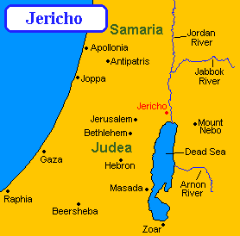
Jerusalem is 2500 feet above sea level and Jericho is 800 feet below sea level.
16-18 miles from Jerusalem to Jericho

Slide 14
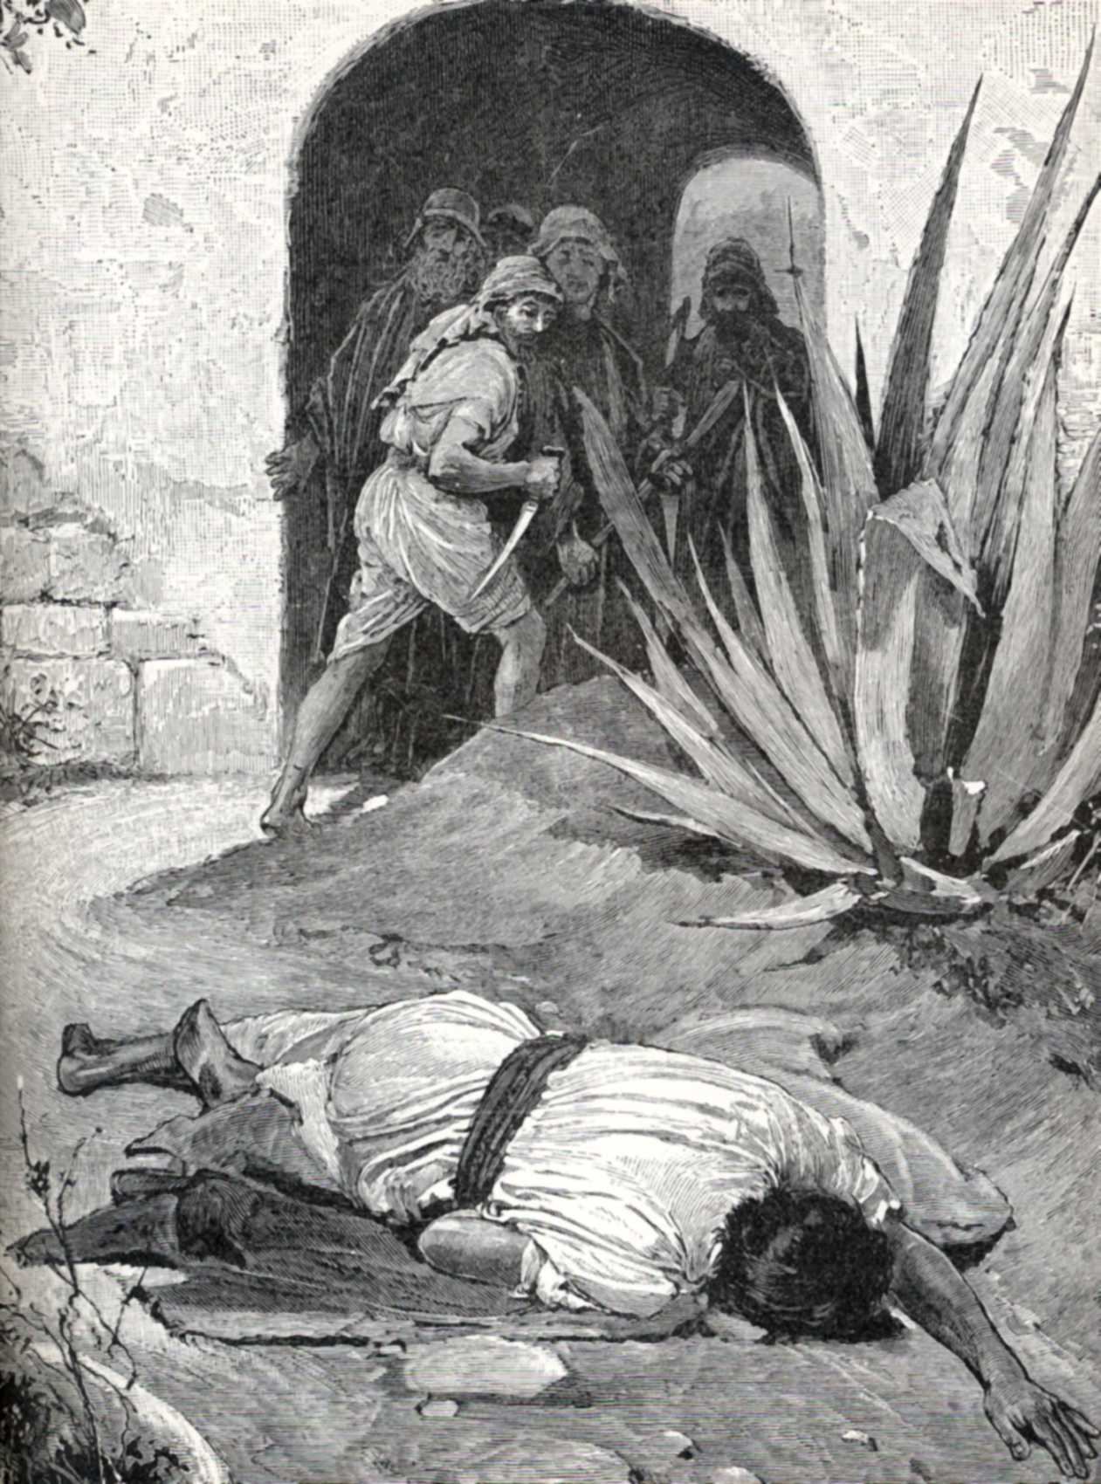

Slide 15
Luke 10:31 "Now by chance a certain priest came down that road. And when he saw him, he passed by on the other side.

Slide 16
Numbers 19:11 ' He who touches the dead body of anyone shall be unclean seven days. ¹² 'He shall purify himself with the water on the third day and on the seventh day; then he will be clean. But if he does not purify himself on the third day and on the seventh day, he will not be clean. ¹³ 'Whoever touches the body of anyone who has died, and does not purify himself, defiles the tabernacle of the LORD. That person shall be cut off from Israel. He shall be unclean, because the water of purification was not sprinkled on him; his uncleanness is still on him.

Slide 17
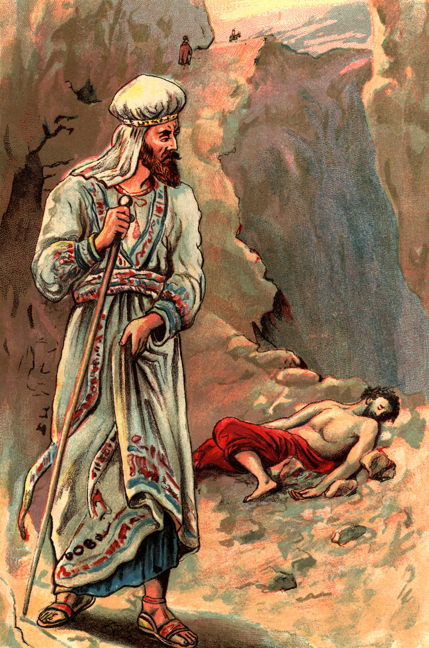
³² "Likewise a Levite, when he arrived at the place, came and looked, and passed by on the other side.

Slide 18
Luke 10:33 "But a certain Samaritan, as he journeyed, came where he was. And when he saw him, he had compassion. ³⁴ "So he went to him and bandaged his wounds, pouring on oil and wine; and he set him on his own animal, brought him to an inn, and took care of him.

Slide 19
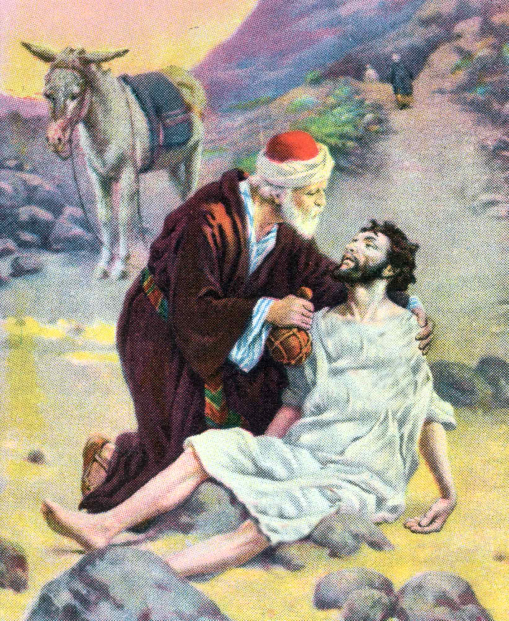
He poured in wine (to likely wash out the wounds). He poured on oil to mollify and close up the wounds. These ingredients were commonly carried by travelers (Gen. 28:18; Jos. 9:13) (The Schertz Leturship p.192)

Slide 20
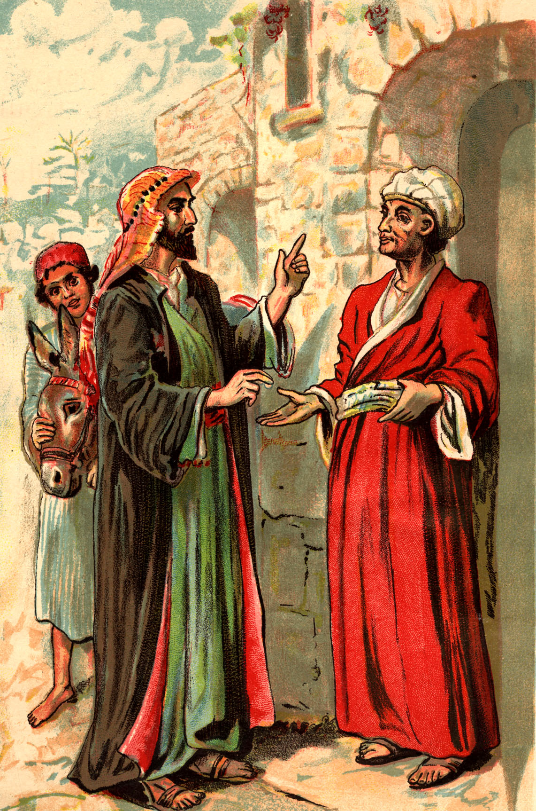
Luke 10:35 "On the next day, when he departed, he took out two denarii, gave them to the innkeeper, and said to him, 'Take care of him; and whatever more you spend, when I come again, I will repay you.'

Slide 21
Luke 10:36 "So which of these three do you think was neighbor to him who fell among the thieves?" ³⁷ And he said, "He who showed mercy on him." Then Jesus said to him, "Go and do likewise."

Slide 22
Luke 10:38 Now it happened as they went that He entered a certain village; and a certain woman named Martha welcomed Him into her house. ³⁹ And she had a sister called Mary, who also sat at Jesus' feet and heard His word. ⁴⁰ But Martha was distracted with much serving, and she approached Him and said, "Lord, do You not care that my sister has left me to serve alone? Therefore tell her to help me." ⁴¹ And Jesus answered and said to her, "Martha, Martha, you are worried and troubled about many things. ⁴² "But one thing is needed, and Mary has chosen that good part, which will not be taken away from her."

Slide 23
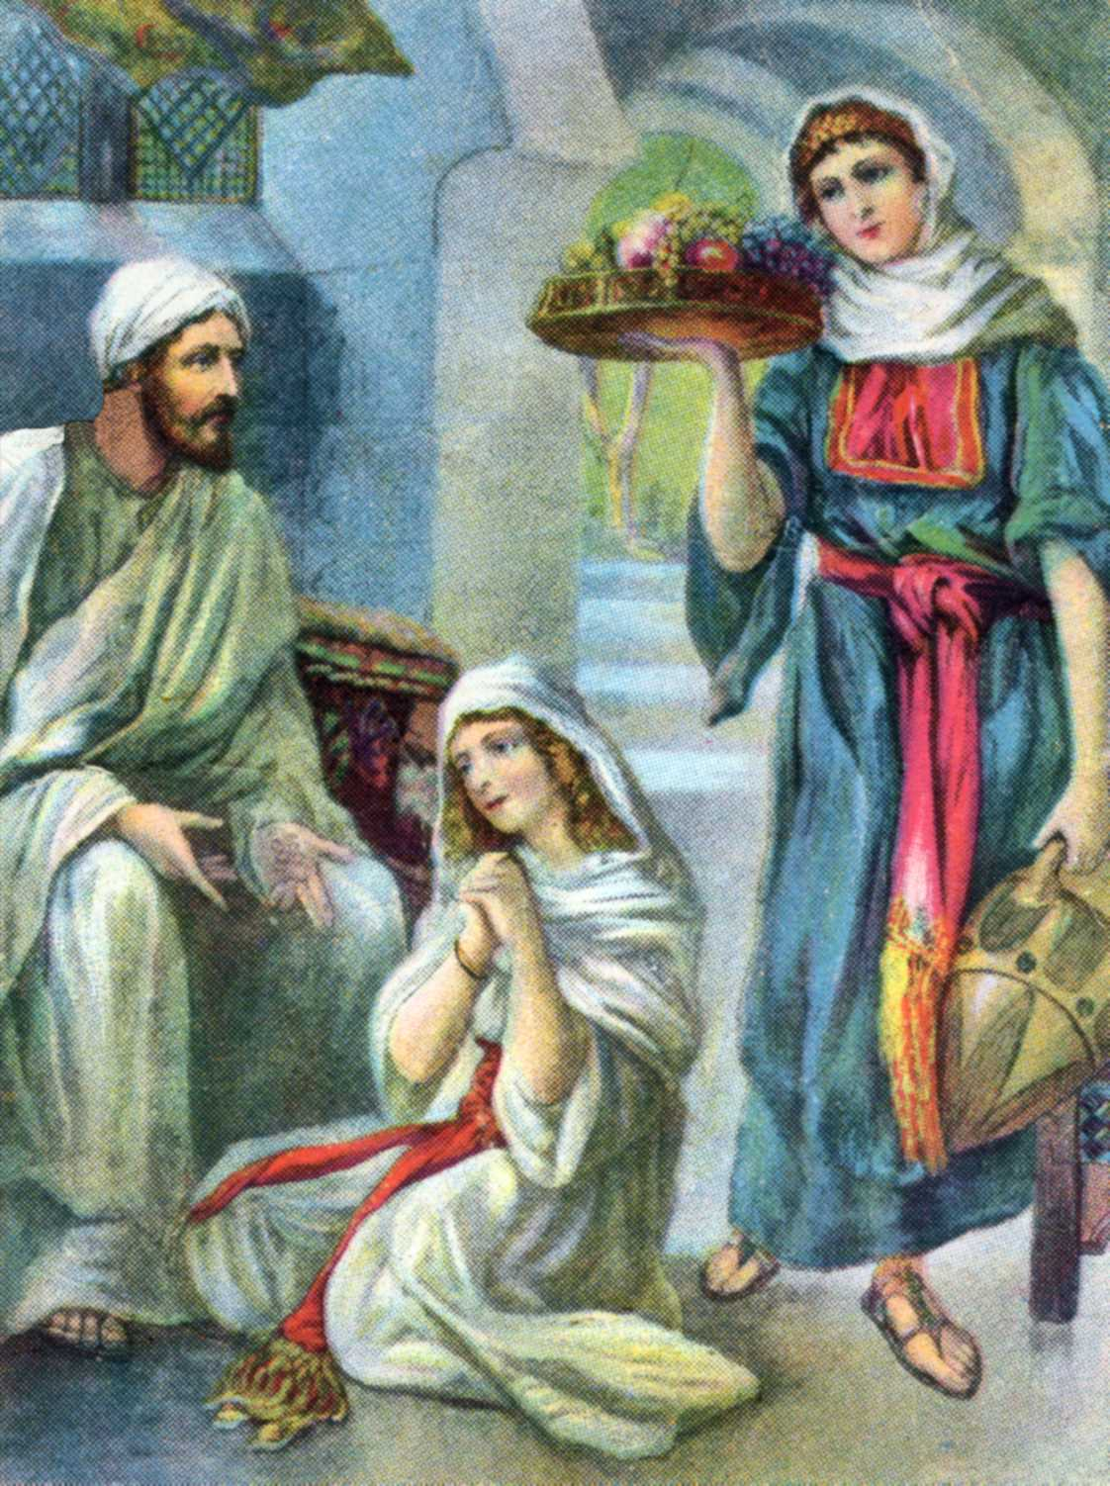

Slide 24
1 Peter 4:9 Be hospitable to one another without grumbling.

Slide 25
Matthew 4:4 … "It is written, 'Man shall not live by bread alone, but by every word that proceeds from the mouth of God.' "

Slide 26
2 Thessalonians 3:10 For even when we were with you, we commanded you this: If anyone will not work, neither shall he eat.
1 Timothy 5:8 But if anyone does not provide for his own, and especially for those of his household, he has denied the faith and is worse than an unbeliever.

Slide 27
Matthew 6:33 "But seek first the kingdom of God and His righteousness, and all these things shall be added to you.

Slide 28
⁴⁰ But Martha was distracted with much serving, and she approached Him and said, "Lord, do You not care that my sister has left me to serve alone? Therefore tell her to help me."

Slide 29
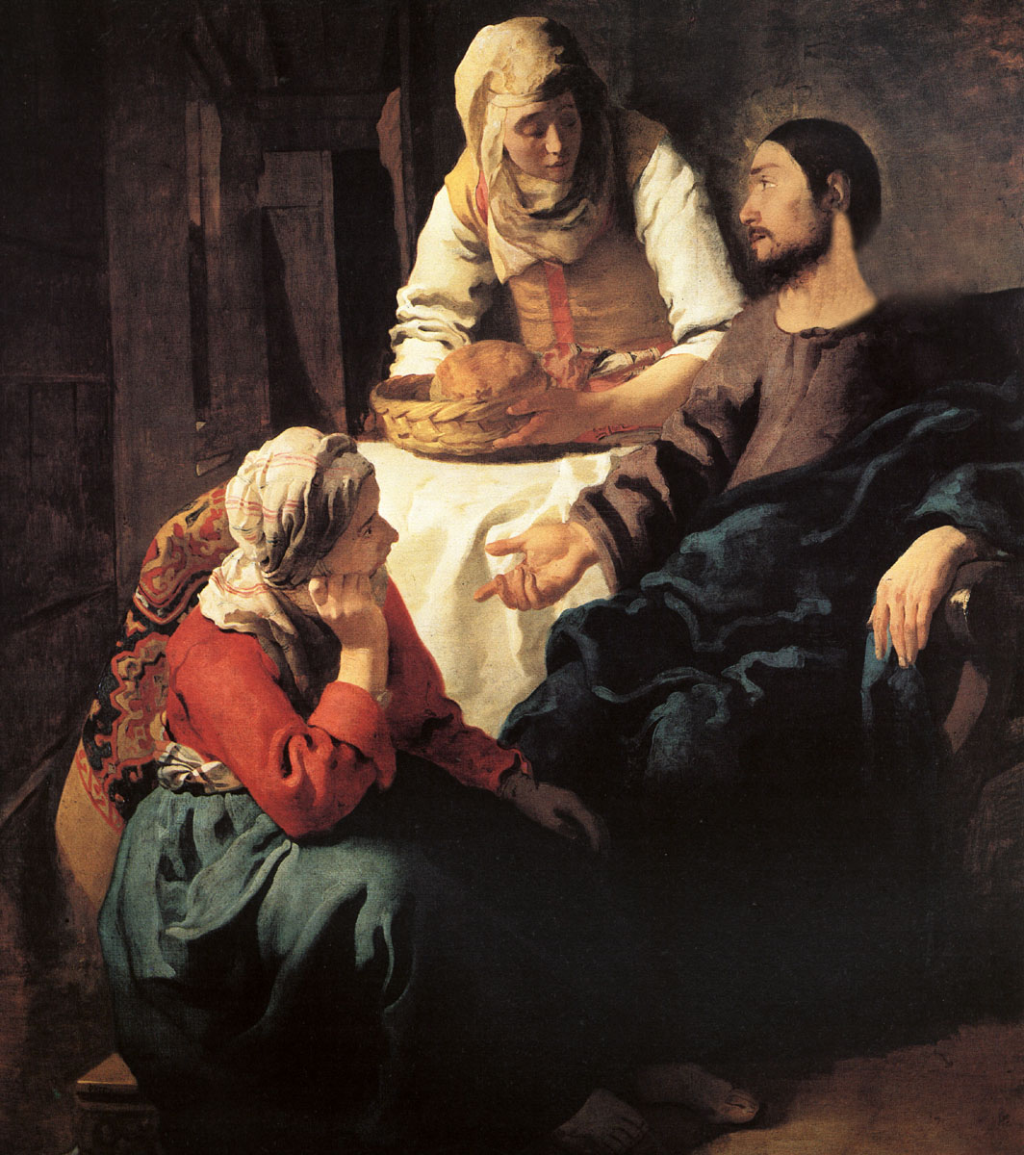

Slide 30
Romans 12:4 For as we have many members in one body, but all the members do not have the same function, ⁵ so we, being many, are one body in Christ, and individually members of one another.

Slide 31
…"Martha, Martha, you are worried and troubled about many things. ⁴² "But one thing is needed, and Mary has chosen that good part, which will not be taken away from her."

Slide 32
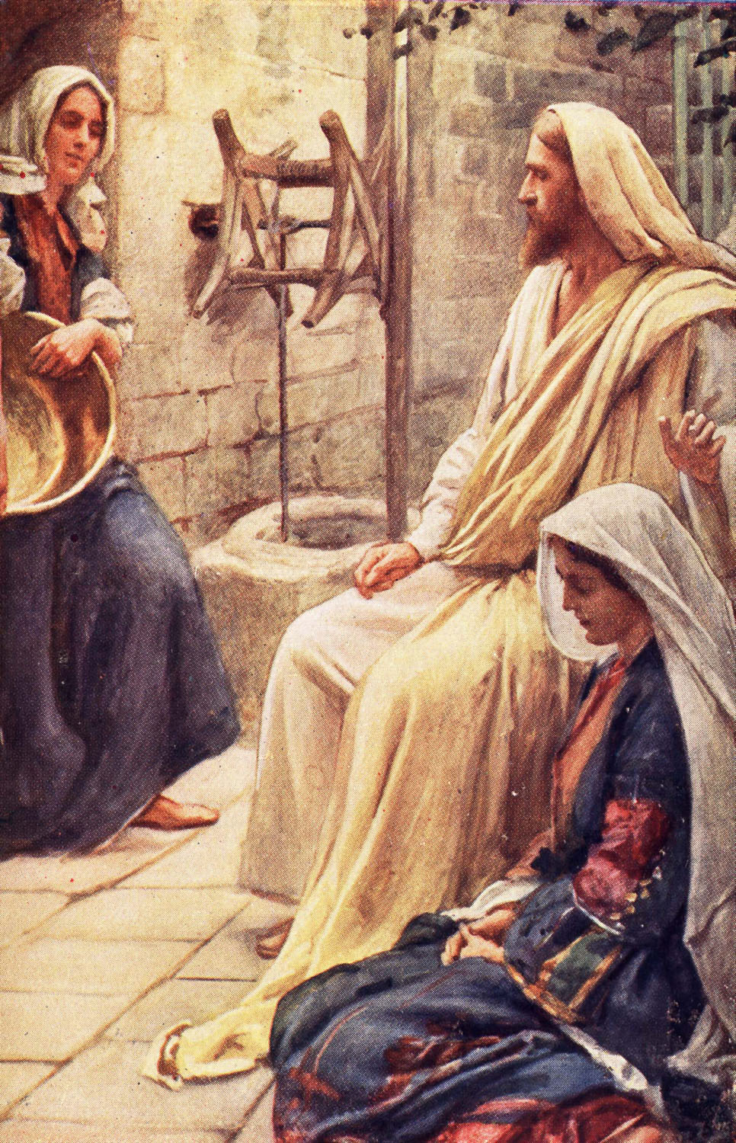

Slide 33
you are worried and troubled about many things. ⁴² "But one thing is needed, and Mary has chosen that good part, which will not be taken away from her."

